Slide 1
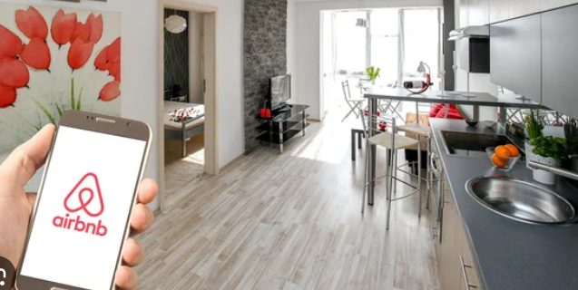

Airbnb is an online marketplace that connects people looking for accommodations with those who have spaces available for short-term or long-term stays.
Keywords:
Variety of Accommodations
Host Services
Guest Experience
Global Reach

Slide 2
DATA EXPLORING
This data has 26 features and 102599 records. This is a raw data where there are many attributes which are not required for further analysis.
This dataset contains the information about the host, neighbourhood, location in terms of latitude and longitude, price, service fees, information about reviews by the customers.

Slide 3
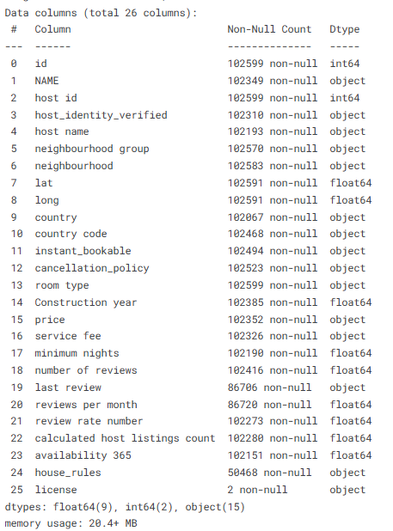
DATA EXPLORING
Columns dropped:
Name
Country
country code
House rules
license
last review

Slide 4
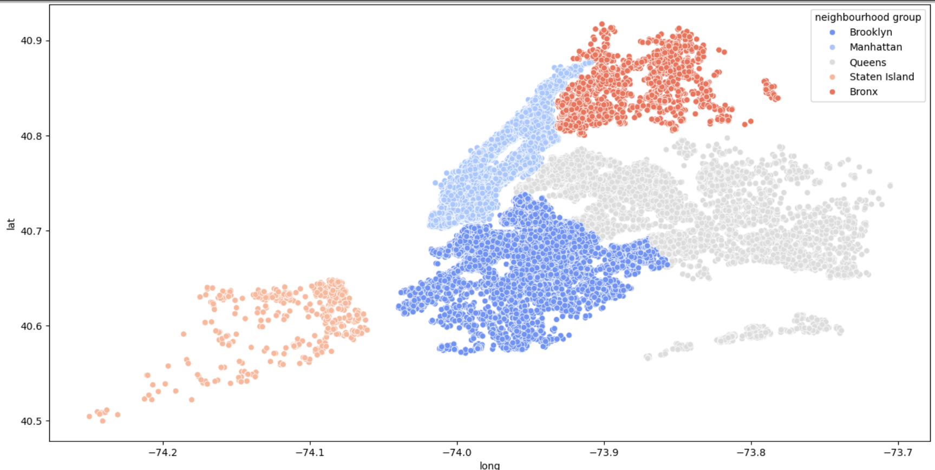
Data Insights

Slide 5
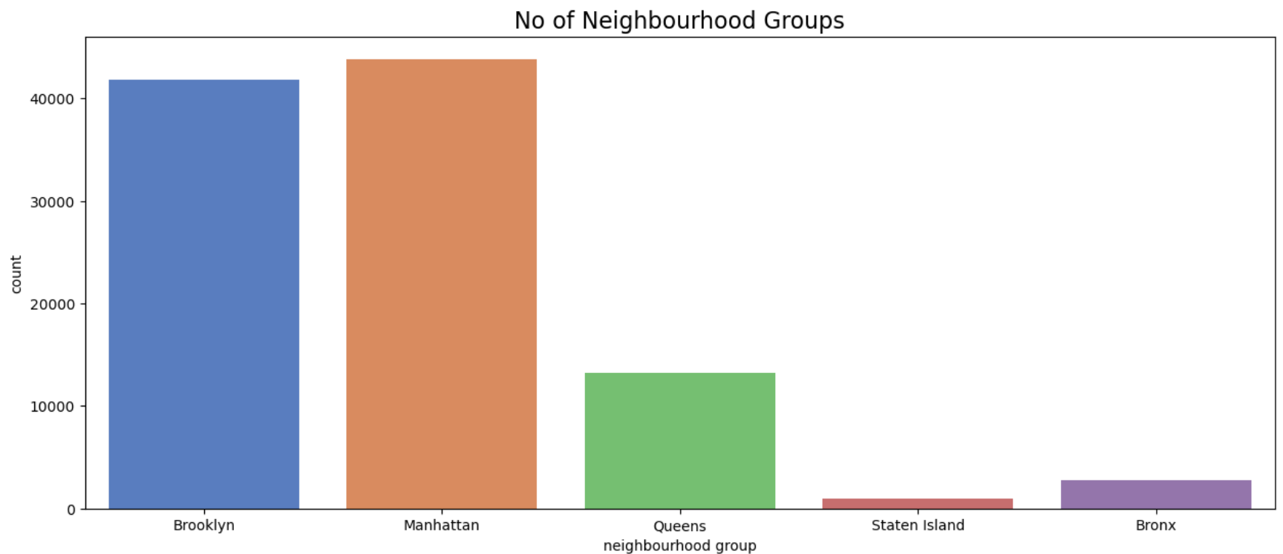
Data Insights
INSIGHTS:
Popularity of Neighborhood Groups
Market Concentration
Demand and Supply Trends
Target Market Planning
Potential for Expansion

Slide 6
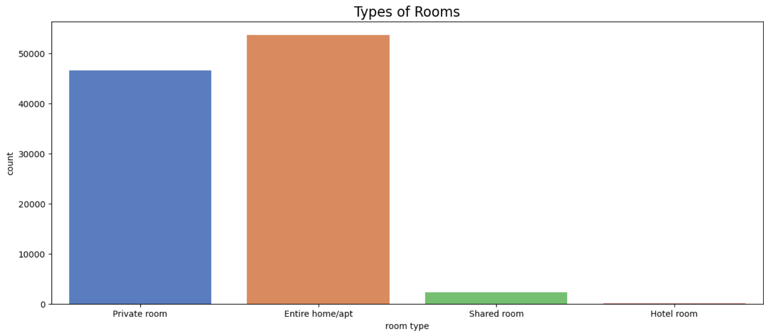
Data Insights
INSIGHTS:
Most Common Room Type
Least Common Room Type
Supply Trends
Market Segmentation
Potential Opportunities

Slide 7
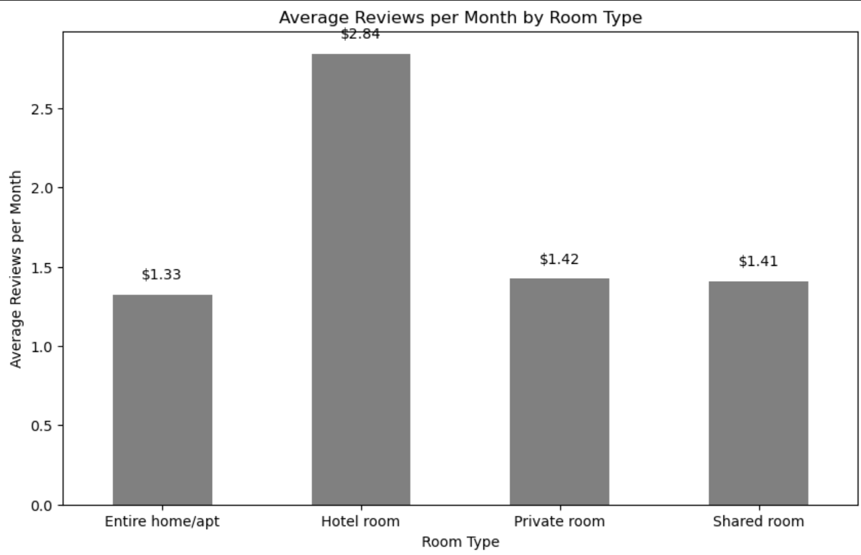
Data Insights
The highest reviews per month by Room type is for Hotel Room. However, the lowest average reviews is for Entire Home/Apartment.

Slide 8
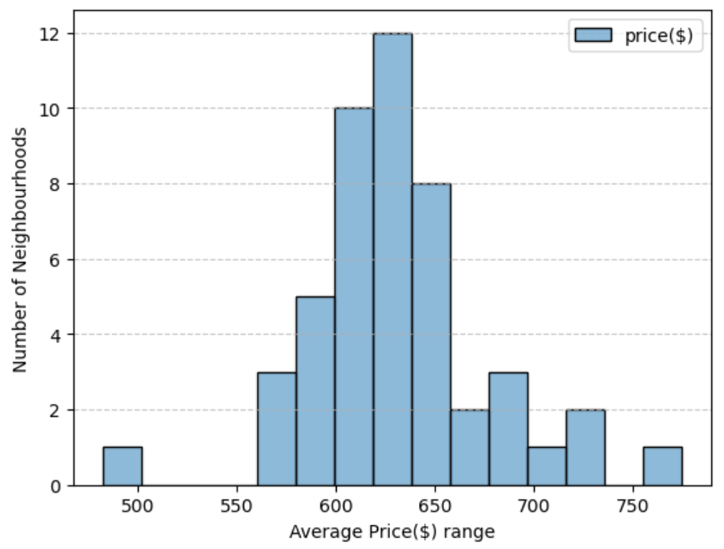
Data Insights
This graph shows number of neighbourhood in Brooklyn with its price.
Are there any high or low outliers?
There are bars far away from the rest (very high or low prices), it indicates that some neighbourhoods are significantly more or less expensive.
What is the typical average price range for Brooklyn neighbourhoods?
Approximately 620 to 640 dollars

Slide 9
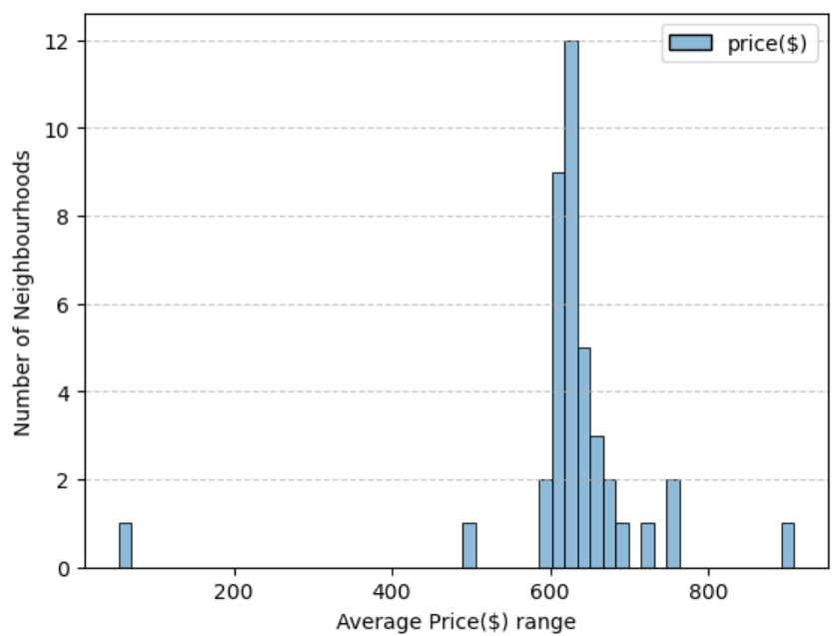
Data Insights
This graph shows number of neighbourhoods in a neighbourhood group Manhattan with its price.

Slide 10
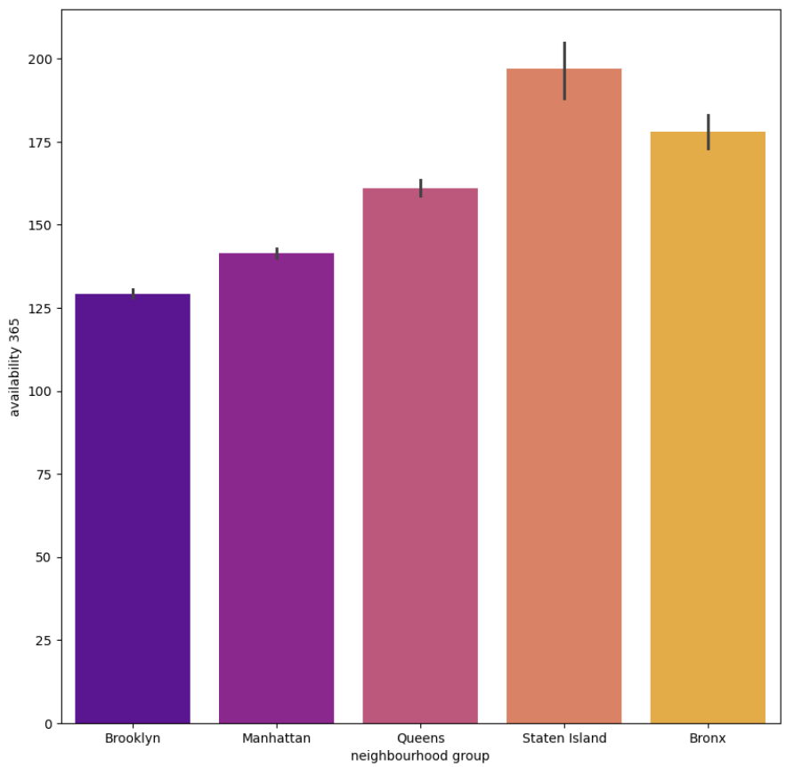
Data Insights
This graph depicts that most of the availability of the Airbnb rooms are in the neighborhood group named Staten Island and the least availability is for Brooklyn.

Slide 11

Special Thanks to Professor Div Pithadia for the guidance throughout the journey.

